Slide 1
7
Interest Rates and Bond Valuation

Slide 2

Chapter 7– Index of Sample Problems
Slide # 02 - 03 Coupon payment
Slide # 04 - 06 Bond price
Slide # 07 - 08 Time to maturity
Slide # 09 - 10 Yield to maturity
Slide # 11 - 13 Current yield
Slide # 14 - 15 Holding period yield
Slide # 16 - 22 Interest rate risk
Slide # 23 - 29 Zero coupon bond
Slide # 30 - 31 Corporate bond quote
Slide # 32 - 33 Clean vs. dirty price
Slide # 34 - 37 Treasury bond quote
Slide # 38 - 39 Tax equivalent yield
Slide # 40 - 43 Fisher effect

Slide 3
2: Coupon payment
A bond has a 7% coupon and pays interest semi-annually.
What is the amount of each interest payment if the face value of a bond is $1,000?

Slide 4
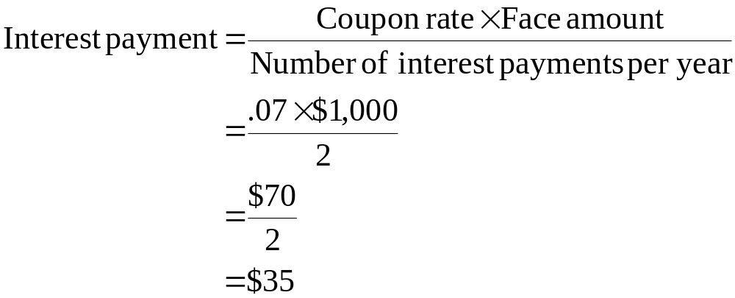
3: Coupon payment

Slide 5
4: Bond price
A bond has a 9% coupon rate, matures in 12 years and pays interest semi-annually. The face value is $1,000.
What is the current price of this bond if the market rate of return is 8.3%?

Slide 6
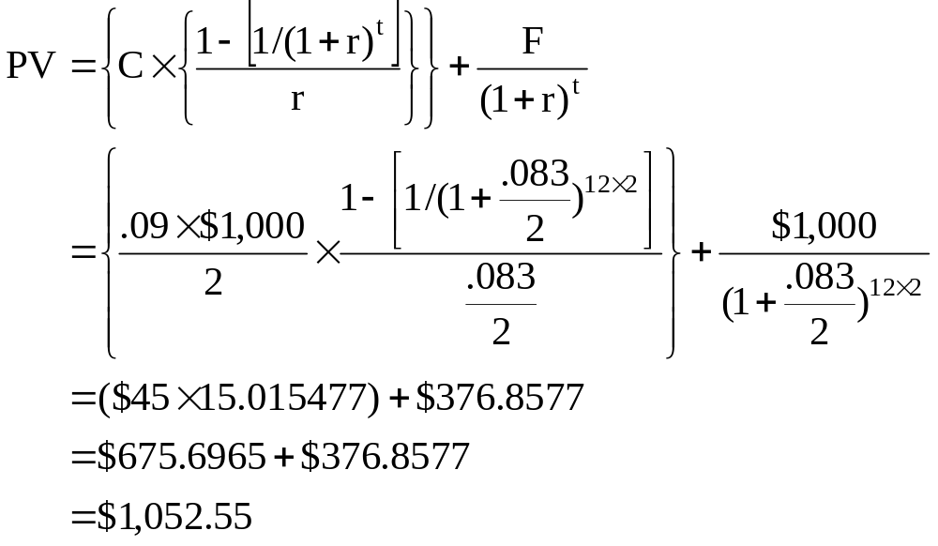
5: Bond price

Slide 7
6: Bond price
Enter 12×2 8.3/2 90/2 1,000
N I/Y PV PMT FV
Solve for ±1,052.55

Slide 8
7: Time to maturity
A bond is currently selling at a price of $977.03. The face value is $1,000 and the coupon rate is 8%. Interest is paid semi-annually.
How many years is it until this bond matures if the market rate of return is 8.4%?

Slide 9
8: Time to maturity
Enter 8.4/2 ±977.03 80/2 1,000
N I/Y PV PMT FV
Solve for 16
There are 16 semi-annual periods, or 8 years, until the bond maturity date.

Slide 10
9: Yield to maturity
A 6% bond pays interest annually and matures in 14 years. The face value is $1,000 and the current market price is $896.30.
What is the yield to maturity?

Slide 11
10: Yield to maturity
Enter 14 ±896.30 60 1,000
N I/Y PV PMT FV
Solve for 7.2

Slide 12
11: Current yield
An 8%, semi-annual coupon bond has a $1,000 face value and matures in 8 years.
What is the current yield on this bond if the yield to maturity is 7.8%?

Slide 13
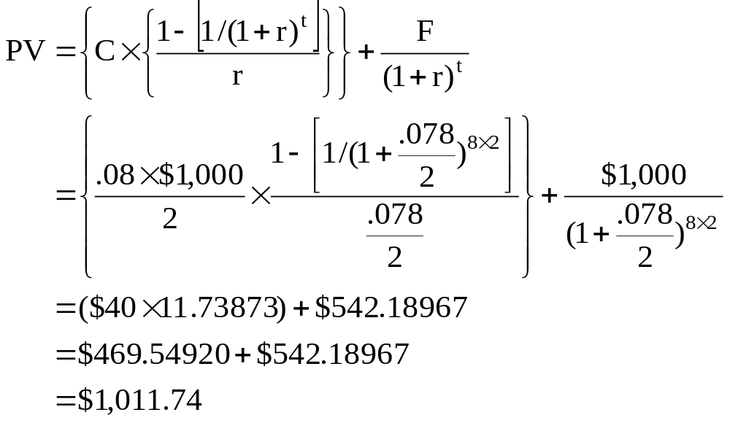
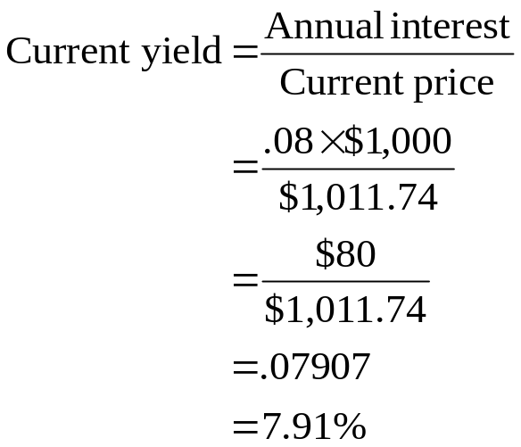
12: Current yield

Slide 14
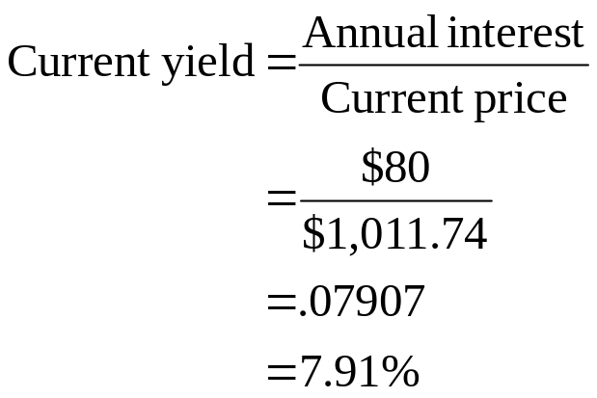
13: Current yield
Enter 8×2 7.8/2 80/2 1,000
N I/Y PV PMT FV
Solve for ±1,011.74

Slide 15
14: Holding period yield
You bought a bond exactly one year ago for $1,004.50. Today, you sold the bond at a price of $987.40. The bond paid interest semi-annually at a coupon rate of 6%.
What is your holding period yield on this bond?

Slide 16
15: Holding period yield
Enter 1×2 /2 ±1,004.50 60/2 987.40
N I/Y PV PMT FV
Solve for 4.29

Slide 17
16: Interest rate risk
You own two bonds. Both bonds have a 6% coupon and pay interest semi-annually. Both have a face value of $1,000. Bond A matures in two years while bond B matures in 10 years.
What is the price of each bond at a market rate of 6%? What happens if the rate increases to 7%.

Slide 18
17: Interest rate risk
Bond A:
Enter 2×2 6/2 60/2 1,000
N I/Y PV PMT FV
Solve for ±1,000
Bond B:
Enter 10×2 6/2 60/2 1,000
N I/Y PV PMT FV
Solve for ±1,000

Slide 19
18: Interest rate risk
Bond A:
Enter 2×2 7/2 60/2 1,000
N I/Y PV PMT FV
Solve for ±981.63
Bond B:
Enter 10×2 7/2 60/2 1,000
N I/Y PV PMT FV
Solve for ±928.94

Slide 20
19: Interest rate risk
You own two bonds. Both bonds mature in 5 years, have a $1,000 face value and pay interest annually. Bond X has an 8% coupon rate while bond Y has a 3% coupon rate.
What is the price of each bond if the market rate of return is 7%? What happens to the price of each bond if the market rate falls to 6%?

Slide 21
20: Interest rate risk
Bond X:
Enter 5 7 80 1,000
N I/Y PV PMT FV
Solve for ±1,041.00
Bond Y:
Enter 5 7 30 1,000
N I/Y PV PMT FV
Solve for ±835.99

Slide 22
21: Interest rate risk
Bond X:
Enter 5 6 80 1,000
N I/Y PV PMT FV
Solve for ±1,084.25
Bond Y:
Enter 5 6 30 1,000
N I/Y PV PMT FV
Solve for ±873.63

Slide 23
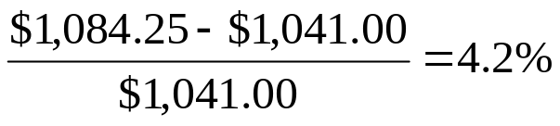
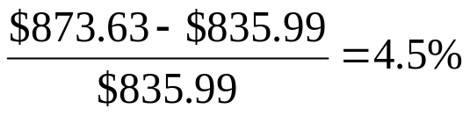
22: Interest rate risk
Market Bond X Bond Y
Rate 8% coupon 3% coupon
7% $1,041.00 $835.99
6% $1,084.25 $873.63
% change 4.2% 4.5%

Slide 24
23: Zero coupon bond
You are considering purchasing a 10-year, zero coupon bond with a face value of $1,000.
How much are you willing to pay for this bond if you want to earn a 12% rate of return? Assume annual compounding.

Slide 25
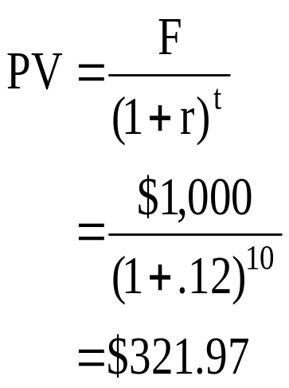
24: Zero coupon bond

Slide 26
25: Zero coupon bond
Enter 10 12 1,000
N I/Y PV PMT FV
Solve for ±321.97

Slide 27
26: Zero coupon bond
Winslow, Inc. issues 20-year zero coupon bonds at a price of $224.73. The face value is $1,000.
What is the amount of the implicit interest for the first year of this bond’s life?

Slide 28
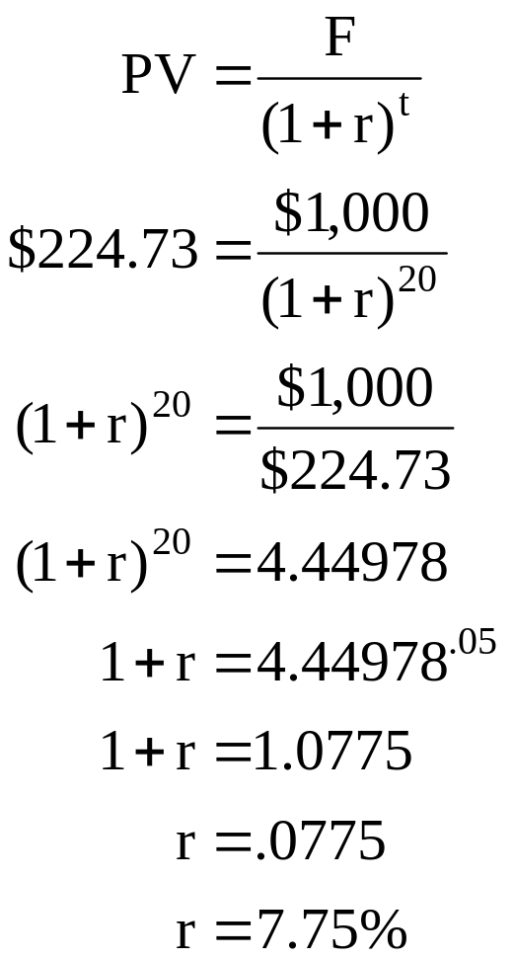
27: Zero coupon bond

Slide 29
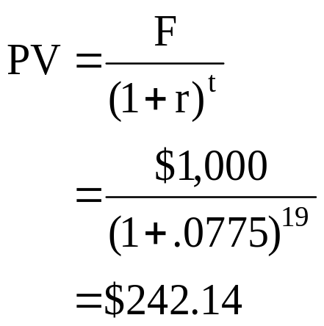
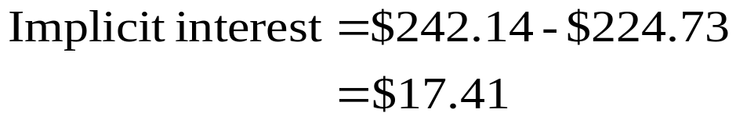
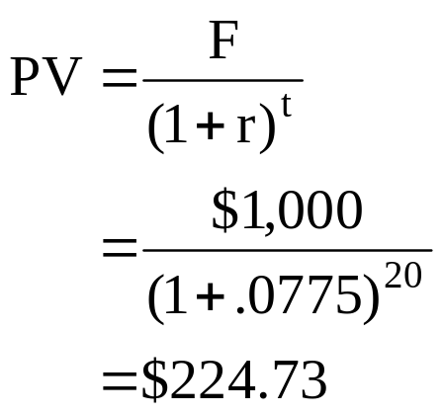
28: Zero coupon bond

Slide 30
29: Zero coupon bond
Enter 19 ±242.14 1,000 N I/Y PV PMT FV
Solve for 7.75
Enter 20 7.75 1,000
N I/Y PV PMT FV
Solve for ±224.73
Implicit interest = $242.14 - $224.73 = $17.41

Slide 31
30: Corporate bond quote
The closing price of a bond is quoted in the newspaper as 101.366.
What is the market price if the face value is $1,000?

Slide 32
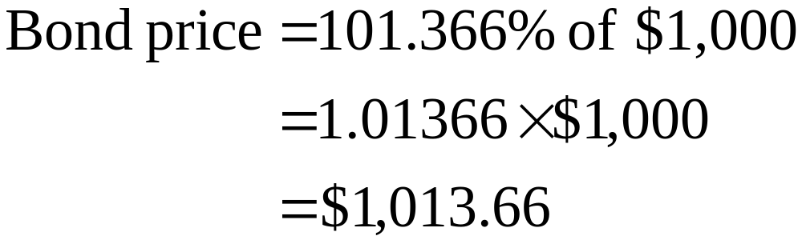
31: Corporate bond quote

Slide 33
32: Clean vs. dirty price
Today, you purchased a bond for $1,065. The bond has an 8% coupon rate, a $1,000 face value and pays interest semi-annually. The next payment date is one month from today.
What is the clean price of this bond?

Slide 34
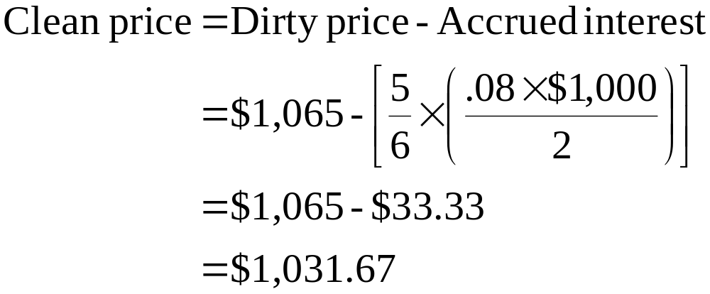
33: Clean vs. dirty price

Slide 35
34: Treasury bond quote
The price of a Treasury bond as quoted in the newspaper is 98:28.
How much will you have to pay to purchase a $100,000 bond?

Slide 36
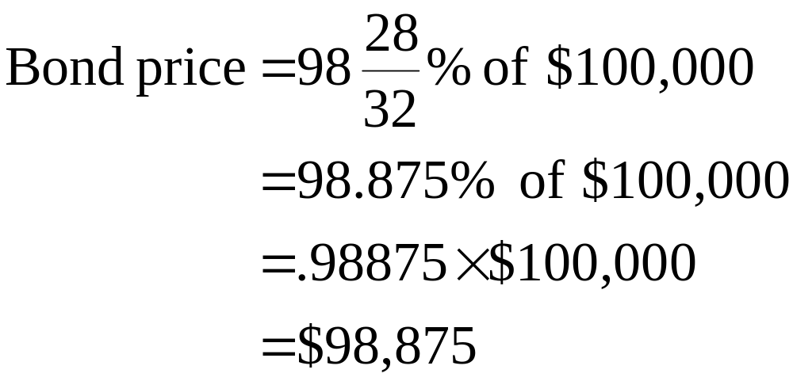
35: Treasury bond quote

Slide 37
36: Treasury bond quote
A Treasury bond has a bid quote of 105:25 and an asked quote of 105:26.
How much will the dealer earn by buying and then selling a $100,000 Treasury bond?

Slide 38
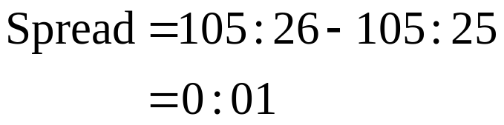
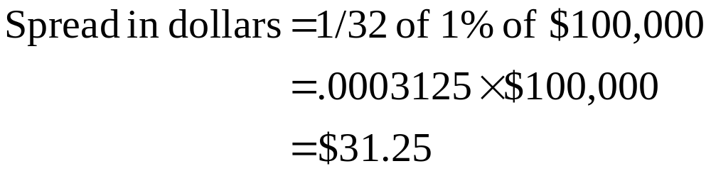
37: Treasury bond quote

Slide 39
38: Tax equivalent yield
You are trying to decide whether you prefer a corporate bond with a 7% coupon or a municipal bond with a 5% coupon. Since all the other aspects of the bonds are equivalent as far as you are concerned, only the annual income is a decision factor.
Which bond should you select if you are in the 25% tax bracket?

Slide 40
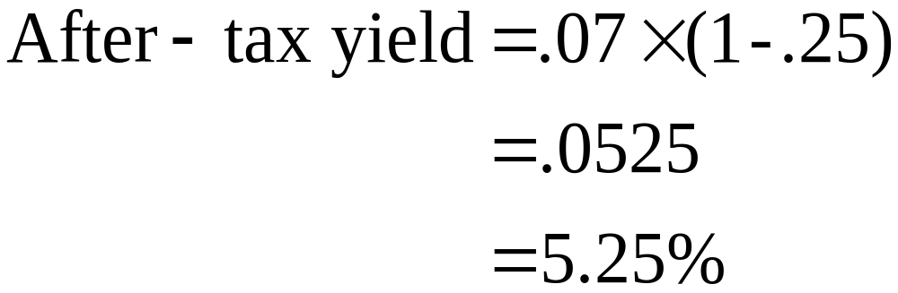
39: Tax equivalent yield
The corporate bond pays 5.25% on an after-tax basis.
The municipal bond pays 5% after taxes.
You should select the corporate bond.

Slide 41
40: Fisher effect
Last year, you earned 14.59% on your investments. The inflation rate was 4.30% for the year.
What was your real rate of return for the year?

Slide 42
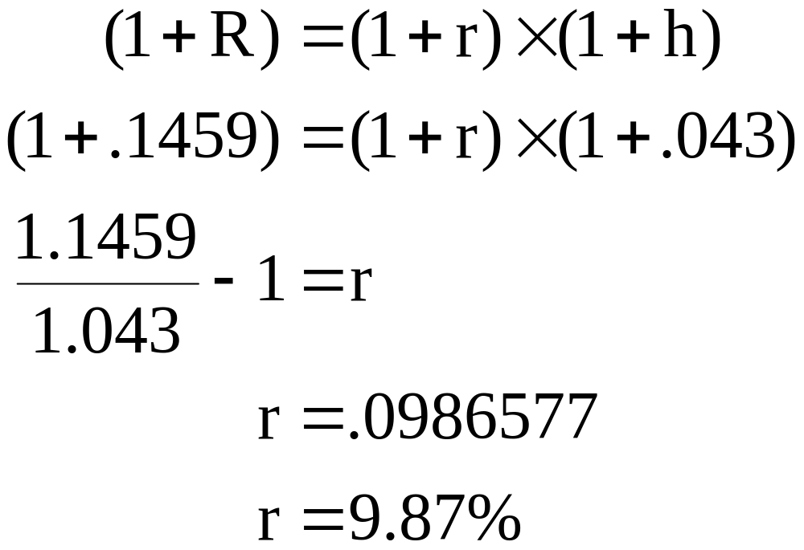
41: Fisher effect

Slide 43
42: Fisher effect
You are considering investing $10,000 for one year. You would like to earn 9%, after inflation, on this investment. You expect inflation to average 3.25% over the coming year.
What nominal rate of return do you want to earn on your investment?

Slide 44
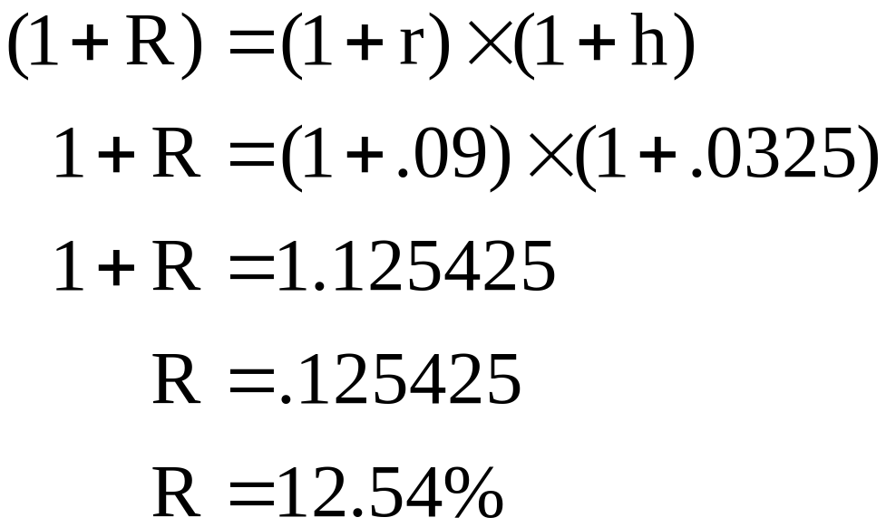
43: Fisher effect

Slide 45
7
End of Chapter 7

